Slide 1

Airbnb Hotel Booking Analysis
Mohammad Tausif
INTERNSHIP_17546440516895be537820f

Slide 2

PROBLEM STATEMENT
Airbnb is a popular platform where property owners rent out their homes or apartments to travelers. One of the biggest challenges for hosts is deciding the right price for their listings, since prices vary depending on several factors such as the number of bedrooms, number of bathrooms, cleanliness, accuracy of descriptions, and communication quality with guests.

Slide 3
Project Description
Data Cleaning & Preprocessing: We handled missing values, corrected data types, and removed duplicates to ensure the integrity and accuracy of our analysis.
Exploratory Data Analysis (EDA): We investigated the dataset to uncover patterns related to:
Geographical Distribution: Identified which boroughs and neighborhoods dominate the market.
Pricing Insights: Analyzed price variations by location and room type.
Market Composition: Determined the most common types of listings available.
Visualization & Dashboarding: We created a series of clear visualizations (charts, graphs, and maps) and developed an interactive dashboard to present our findings in an accessible and engaging way.

Slide 4
WHO ARE THE END USERS?
Travelers & Tourists:
Can make informed, budget-conscious decisions on where to stay.
Can better understand the types of accommodations available in different parts of the city.
Current & Aspiring Airbnb Hosts:
Can develop competitive pricing strategies based on market data.
Can identify opportunities in underserved neighborhoods or with specific room types.
Market Analysts & Researchers:
Can use the findings to study urban tourism and the impact of the sharing economy.
Can leverage the cleaned dataset for more advanced predictive modeling.

Slide 5

Technology Used
Python: The core programming language for the analysis.
Pandas: The primary library for high-performance data manipulation and cleaning.
Matplotlib & Seaborn: Used for creating static, high-quality data visualizations like bar charts, histograms, and heatmaps.
Plotly: Leveraged for creating interactive charts within the dashboard.
Streamlit: The framework used to rapidly build and deploy the interactive web-based dashboard.

Slide 6
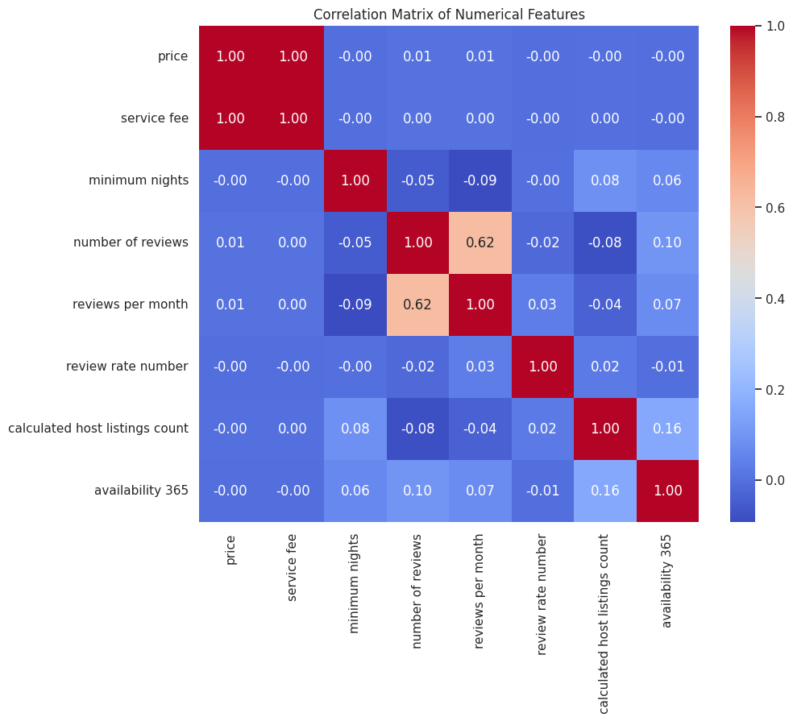
RESULTS1
[Add screen shots of your code or Chart(s) ]

Slide 7
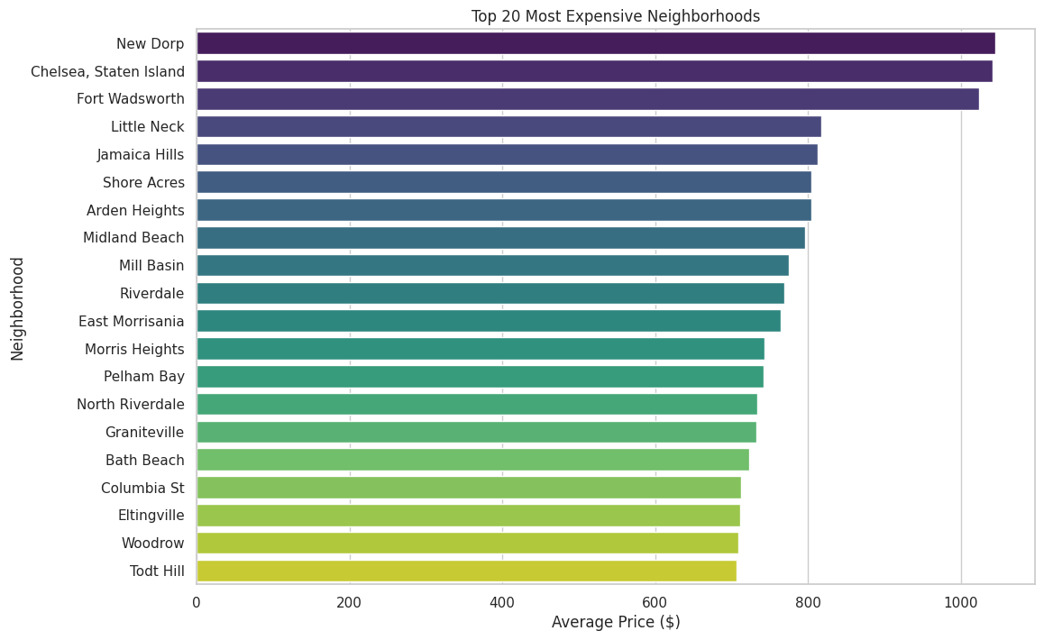
RESULTS2
[Add screen shots of your code or Chart(s) ]

Slide 8
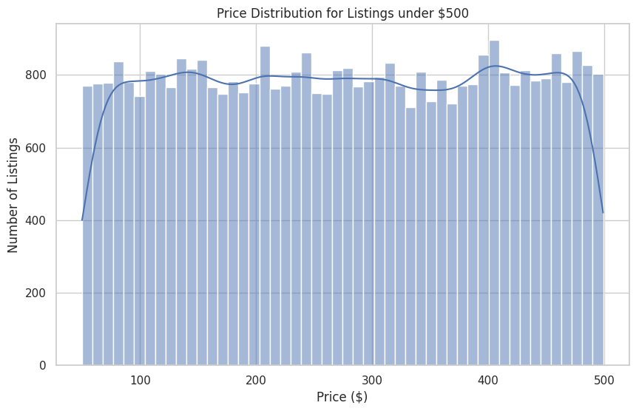
RESULTS3
[Add screen shots of your code or Chart(s) ]

Slide 9
GitHub repository
https://github.com/whoistausif/VOIS_AICTE_Oct2025_MOHAMMAD_TAUSIF
Demo Link

Slide 10
Getting started with Basics of Python Certificate
[Paste your Certificate Here]

Slide 11
Data Visualization Certificate
[Paste your Certificate Here]

Slide 12
Thank you
.
.

